Slide 1
Sensitivity Analysis
7
To accompany
Quantitative Analysis for Management, Twelfth Edition,
by Render, Stair, Hanna and Hale
Power Point slides created by Jeff Heyl
Copyright ©2015 Pearson Education, Inc.

Slide 2
LEARNING OBJECTIVES
After completing this chapter, students will be able to:
Understand the basic concepts of linear programming (LP).
Understand the role of sensitivity analysis.
Use Excel spreadsheets to solve LP problems.

Slide 3
Introduction
Many management decisions involve making the most effective use of limited resources
Linear programming (LP)
  Widely used mathematical modeling technique
  Planning and decision making relative to resource allocation
Broader field of mathematical programming
  Here programming refers to modeling and solving a problem mathematically

Slide 4
Requirements of a
Linear Programming Problem
Four properties in common
  Seek to maximize or minimize some quantity (the objective function)
  Restrictions or constraints are present
  Alternative courses of action are available
  Linear equations or inequalities

Slide 5
Formulating LP Problems
Developing a mathematical model to represent the managerial problem
Steps in formulating a LP problem
  Completely understand the managerial problem being faced
  Identify the objective and the constraints
  Define the decision variables
  Use the decision variables to write mathematical expressions for the objective function and the constraints

Slide 6
Formulating LP Problems
Common LP application – product mix problem
Two or more products are produced using limited resources
Maximize profit based on the profit contribution per unit of each product
Determine how many units of each product to produce

Slide 7
Flair Furniture Company
Flair Furniture produces inexpensive tables and chairs
Processes are similar, both require carpentry work and painting and varnishing
  Each table takes 4 hours of carpentry and 2 hours of painting and varnishing
  Each chair requires 3 of carpentry and 1 hour of painting and varnishing
  There are 240 hours of carpentry time available and 100 hours of painting and varnishing
  Each table yields a profit of $70 and each chair a profit of $50

Slide 8
Flair Furniture Company
The company wants to determine the best combination of tables and chairs to produce to reach the maximum profit
TABLE 7.2
 | HOURS REQUIRED TO PRODUCE 1 UNIT
DEPARTMENT | (T) TABLES | (C) CHAIRS | AVAILABLE HOURS THIS WEEK
Carpentry | 4 | 3 | 240
Painting and varnishing | 2 | 1 | 100
Profit per unit | $70 | $50

Slide 9
Flair Furniture Company
The objective is
Maximize profit
The constraints are
  The hours of carpentry time used cannot exceed 240 hours per week
  The hours of painting and varnishing time used cannot exceed 100 hours per week
The decision variables are
T = number of tables to be produced per week
C = number of chairs to be produced per week

Slide 10
Flair Furniture Company
Create objective function in terms of T and C
Maximize profit = $70T + $50C
Develop mathematical relationships for the two constraints
  For carpentry, total time used is
(4 hours per table)(Number of tables produced)
+ (3 hours per chair)(Number of chairs produced)
  First constraint is
Carpentry time used ≤ Carpentry time available
4T + 3C ≤ 240 (hours of carpentry time)

Slide 11
Solving Flair Furniture’s
LP Problem
Most organizations have access to software to solve big LP problems
There are differences between software implementations, the approach is basically the same
With experience with computerized LP algorithms, it is easy to adjust to minor changes

Slide 12
Using Excel’s Solver
The Solver tool in Excel can be used to find solutions to
  LP problems
  Integer programming problems
  Noninteger programming problems
  Solver is limited to 200 variables and, in some situations, 100 constraints

Slide 13
Using Solver
Recall the model for Flair Furniture is
Maximize profit = $70T + $50C
Subject to 4T + 3C ≤ 240
2T + 1C ≤ 100
To use Solver, it is necessary to enter data and formulas

Slide 14
Using Solver
Enter problem data
  Variable names, coefficients for the objective function and constraints, RHS values for each constraint
Designate specific cells for the values of the decision variables
Write a formula to calculate the value of the objective function
Write a formula to compute the left-hand sides of each of the constraints

Slide 15
Using Solver
PROGRAM 7.2A – Excel Data Input

Slide 16
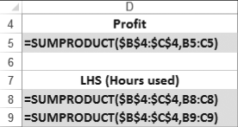
Using Solver
PROGRAM 7.2B – Formulas

Slide 17
Using Solver
PROGRAM 7.2C – Excel Spreadsheet

Slide 18
Using Solver
PROGRAM 7.2D – Starting Solver

Slide 19
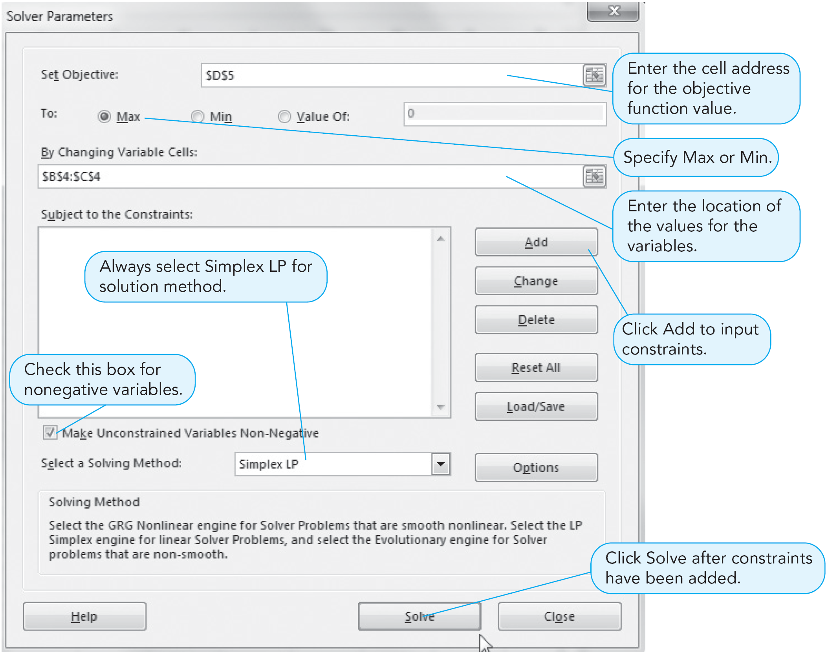
Using Solver
PROGRAM 7.2E –
Solver Parameters
Dialog Box

Slide 20
Using Solver
PROGRAM 7.2F – Solver Add Constraint Dialog Box

Slide 21
Using Solver
PROGRAM 7.2G – Solver Results Dialog Box

Slide 22
Using Solver
PROGRAM 7.2H – Solution

Slide 23
Sensitivity Analysis
Optimal solutions to LP problems thus far have been found under deterministic assumptions
  We assume complete certainty in the data and relationships of a problem
Real world conditions are dynamic
Analyze how sensitive a deterministic solution is to changes in the assumptions of the model
This is called sensitivity analysis, postoptimality analysis, parametric programming, or optimality analysis

Slide 24
Sensitivity Analysis
Involves a series of what-if? questions concerning constraints, variable coefficients, and the objective function
Trial-and-error method
  Values are changed and the entire model is resolved
Preferred way is to use an analytic postoptimality analysis
  After a problem has been solved, we determine a range of changes in problem parameters that will not affect the optimal solution or change the variables in the solution

Slide 25
High Note Sound Company
The company manufactures quality speakers and stereo receivers
Products require a certain amount of skilled artisanship which is in limited supply
Product mix LP model
Maximize profit = | $50X₁ | + $120X₂
subject to | 2X₁ | + 4X₂ | ≤ 80 | (hours of electricians’ time available)
 | 3X₁ | + 1X₂ | ≤ 60 | (hours of audio technicians’ time available)
 |  | X₁, X₂ | ≥ 0

Slide 26
High Note Sound Company
FIGURE 7.16 – The High Note Sound Company Graphical Solution
X₂
(Receivers)
60 –
–
40 –
–
20 –
10 –
0 –
Optimal Solution at Point a
X₁ = 0 Speakers
X₂ = 20 Receivers
Profits = $2,400
a = (0, 20)
b = (16, 12)
Isoprofit Line: $2,400 = 50X₁ + 120X₂
| | | | | |
10 20 30 40 50 60
X₁
c = (20, 0)
(Speakers)

Slide 27
High Note Sound Company
Electrician hours used are
2X₁ + 4X₂ = 2(0) + 4(20) = 80
  All hours are utilized so slack = 0
  Additional units of a binding constraint will generally increase profits
Technician hours used are
3X₁ + 1X₂ = 3(0) + 1(20) = 20
  Available hours = 60 so slack = 60 – 20 = 40
  Additional units of a nonbinding constraint will only increase slack

Slide 28
Changes in the
Objective Function Coefficient
Contribution rates in the objective functions fluctuate
  The feasible solution region remains exactly the same
  The slope of the isoprofit or isocost line changes
Modest increases or decreases in objective function coefficients may not change the current optimal corner point
Know how much an objective function coefficient can change before the optimal solution would be at a different corner point

Slide 29
Changes in the
Objective Function Coefficient
FIGURE 7.17 – Changes in the Receiver Contribution Coefficients
40 –
30 –
20 –
10 –
0 –
X₂
Profit Line for 50X₁ + 80X₂
(Passes through Point b)
Old Profit Line for 50X₁ + 120X₂
(Passes through Point a)
b
a
Profit Line for 50X₁ + 150X₂
(Passes through Point a)
c
| | | | | |
10 20 30 40 50 60
X₁

Slide 30
Excel Solver
PROGRAM 7.7A – Excel Spreadsheet for High Note Sound

Slide 31
Excel Solver
PROGRAM 7.7B – Excel 2013 Solution and Solver Results

Slide 32
Excel Solver
PROGRAM 7.7C –
Excel 2013
Sensitivity Report

Slide 33
Changes in the
Technological Coefficients
Changes in the technological coefficients often reflect changes in the state of technology
If the amount of resources needed to produce a product changes, coefficients in the constraint equations will change
Objective function does not change
May produce significant change in the shape of the feasible region
May cause a change in the optimal solution

Slide 34
Changes in the
Technological Coefficients
FIGURE 7.18 – Change in the Technological Coefficients
(a) Original Problem
(b) Change in Circled Coefficient
(c) Change in Circled Coefficient
60 –
40 –
20 –
60 –
40 –
20 –
60 –
40 –
20 –
X₂
X₂
X₂
3X₁ + 1X₂ ≤ 60
2 X₁ + 1X₂ ≤ 60
3X₁ + 1X₂ ≤ 60
Stereo Receivers
Optimal Solution
Still Optimal
Optimal Solution
a
a
b
d
16
f
2X₁ + 4X₂ ≤ 80
2X₁ + 4X₂ ≤ 80
g
2X₁ + 5 X₂ ≤ 80
c
e
c
| | |
0 20 40
| | |
0 20 40
| | |
0 20 40
|
30
X₁
X₁
X₁
CD Players

Slide 35
Changes in Resources or
Right-Hand-Side Values
Right-hand-side values of the constraints often represent resources available to the firm
Additional resources may lead to higher total profit
Sensitivity analysis about resources helps answer questions about
  How much should be paid for additional resources
  How much more of a resource would be useful

Slide 36
Changes in Resources or
Right-Hand-Side Values
Changing the RHS will change the feasible region, unless the constraint is redundant
Often changes the optimal solution
The dual price or dual value
  The amount of change in the objective function value that results from a unit change in one of the resources
  The dual price for a constraint is the improvement in the objective function value that results from a one-unit increase in the right-hand side of the constraint

Slide 37
Changes in Resources or
Right-Hand-Side Values
The amount of possible increase in the RHS is limited
If the RHS is increased beyond the upper bound, then the objective function would no longer increase by the dual price
There would be excess (slack) resources or the objective function may change by an amount different from the dual price
The dual price is relevant only within limits

Slide 38
Changes in the Electricians’ Time Resource
FIGURE 7.19
60 –
40 –
20 –
X₂
(a)
Constraint Representing 60 Hours of Audio Technician’s Time Resource
25 –
a
b
Changed Constraint Representing 100 Hours of Electrician’s Time Resource
c
| | |
0 20 40 60
|
50
X₁

Slide 39
Changes in the Electricians’ Time Resource
FIGURE 7.19
60 –
40 –
20 –
X₂
(b)
Constraint Representing 60 Hours of Audio Technician’s Time Resource
25 –
Changed Constraint Representing 60 Hours of Electrician’s Time Resource
a
b
c
| | |
0 20 40 60
|
50
X₁

Slide 40
Changes in the Electricians’ Time Resource
FIGURE 7.19
60 –
40 –
20 –
X₂
(c)
Changed Constraint Representing 240 Hours of Electrician’s Time Resource
Constraint Representing
60 Hours of Audio Technician’s
Time Resource
25 –
| | | | | |
0 20 40 60 80 100 120
X₁

Slide 41
Excel Solver
PROGRAM 7.7C –
Excel 2013
Sensitivity Report

Slide 42

Copyright
All rights reserved. No part of this publication may be reproduced, stored in a retrieval system, or transmitted, in any form or by any means, electronic, mechanical, photocopying, recording, or otherwise, without the prior written permission of the publisher. Printed in the United States of America.
Copyright ©2015 Pearson Education, Inc.

